Slide 1
startup analysis
File created on: 06-04-2023 10:50:57

Slide 2
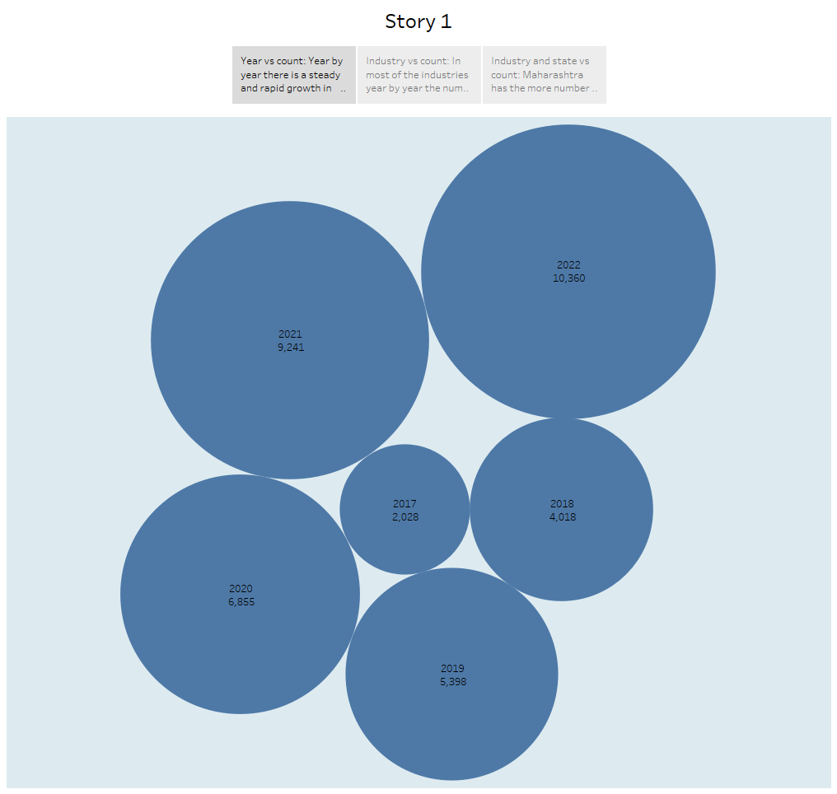

Slide 3
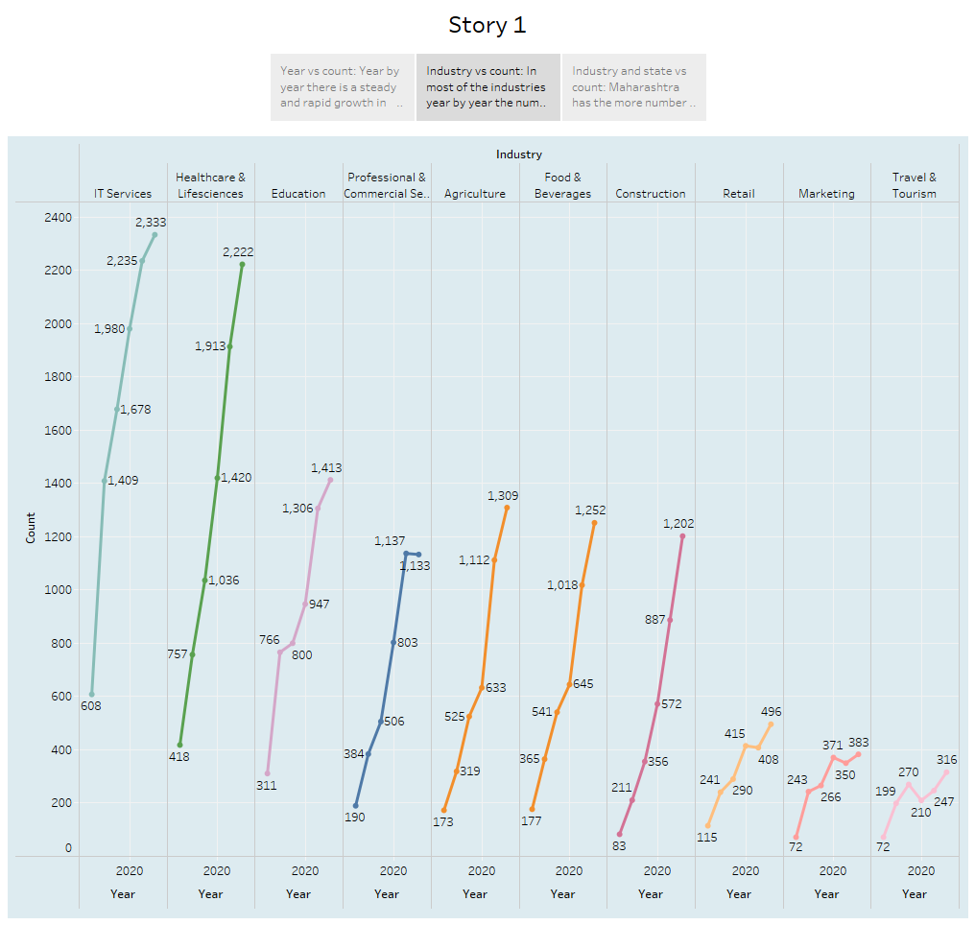

Slide 4
